Slide 1
Mental and Physical Illness (MAPI) Chatbot
Tusheet Goli, Tejas Pradeep, Akshay Sathiya, Pranav Khorana, Sanket Manjesh, Rahul Chawla
tgoli3@gatech.edu, tpradeep8@gatech.edu, asathiya6@gatech.edu, pkhorana3@gatech.edu, smanjesh3@gatech.edu, rchawla36@gatech.edu

Slide 2
Introduction
Definitions
Physical illness: illnesses pertaining to one’s physical health (common cold, flu, etc.)
Mental illness: illnesses pertaining to one’s mental health (anxiety, depression, etc.)
Problem
People may not be able to immediately consult primary healthcare provider upon experiencing symptoms of mental or physical illness.
Determining illness risks helps them know if a doctor’s visit is required how to better take care of themselves.
Solution
Mental and Physical Illness Chatbot

Slide 3
Introduction
Team contributions
Akshay Sathiya: Data processing for Kaggle physical diseases dataset (Patil, 2020), physical illness prediction (PIP) pipeline, and the PIP response builder to generate messages containing physical illness prediction results and precautions to send back to user.
Pranav Khorana: Created front-end React Native application and integrated w/ backend
Tusheet Goli: Worked on API design, backend implementation, and database hosting (Heroku)
Tejas Pradeep: Worked on the backend API design, and integrated front end w/ model
Rahul Chawla: Worked on the mental illness prediction (MIP) pipeline, created the logistic regression model and data processing for emotions dataset (Praveen, 2020)
Sanket Majesh: Worked on the mental illness prediction (MIP) pipeline

Slide 4
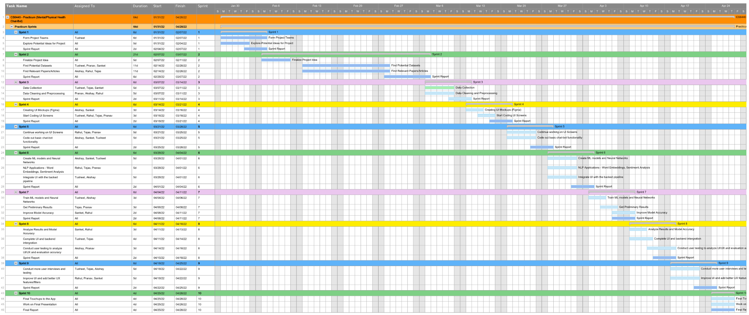
Project Implementation Status

Slide 5
Architecture
Database
Message
Messages
Mobile Client
Server
Message
Message
ML Suite
Response
MIP Pipeline
Predicted Mental Illness Risks
Response Builder
MIP Response
MIP Response Builder
MIP Models
Response
PIP Response
PIP Pipeline
Predicted Physical Illness Risks
Extracted Symptoms
PIP Response Builder
PIP Models
Symptom Extraction
PIP = Physical Illness Prediction
MIP = Mental Illness Prediction

Slide 6

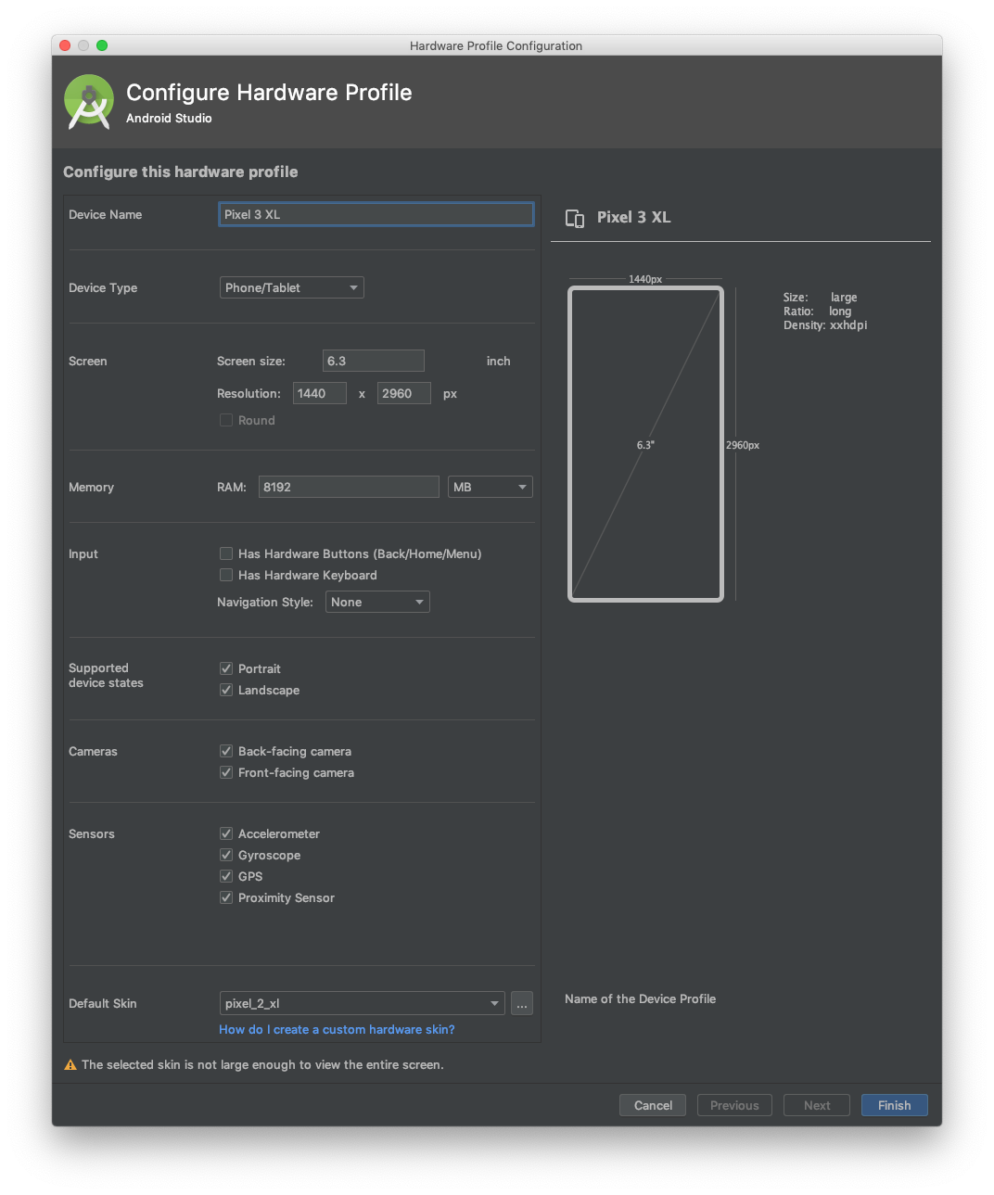
Setting Up Frontend
Used React Native to create front-end application
Easy to deploy mobile apps on both Android and iOS operating systems
Utilized Javascript with Typescript configuration
Android Emulator for testing and debugging
Pixel 3 XL with Android 8.0 operating system
Utilized Expo, a framework that allows users to easily develop, build, and deploy React Native apps

Slide 7
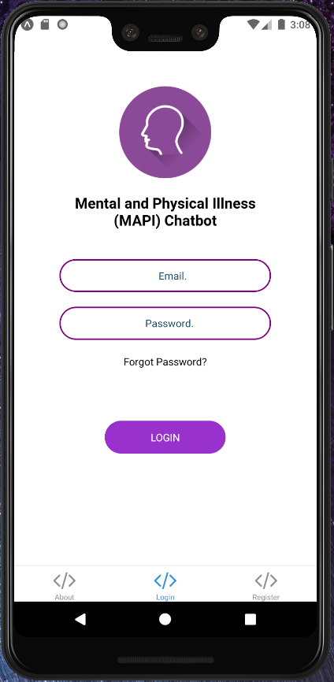
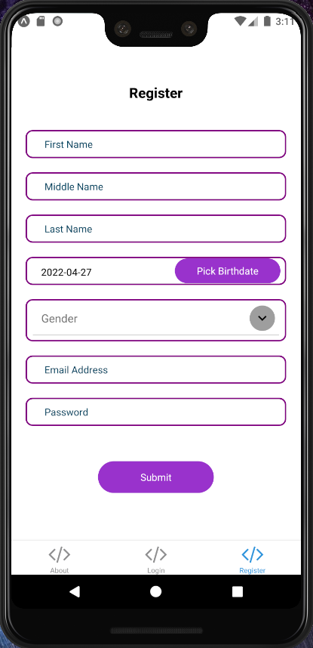
Creating React Native App
React-Navigation and Bottom TabNavigator
Organized hierarchy for user to navigate (logging in and out/switching tabs)
TextInput, Touchable Opacity, Dropdown, DateTime Picker
Utilized a variety of components for user to input info
Registering and logging in

Slide 8
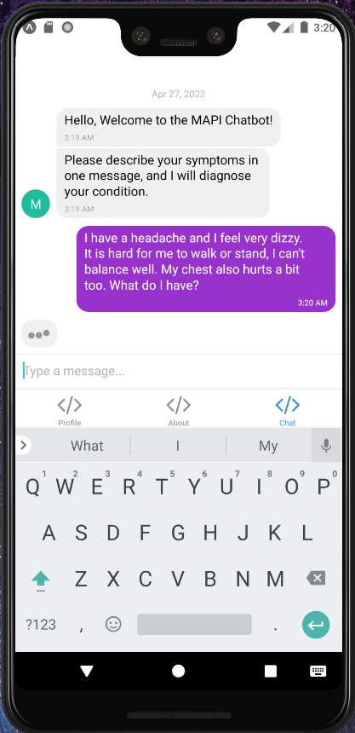
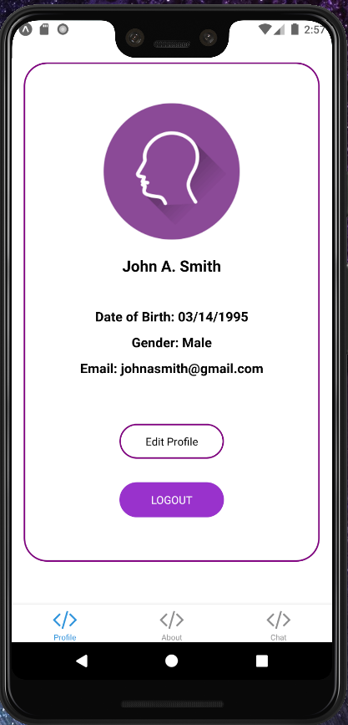
Creating React Native App
Hooks to keep track of state & lifecycle components
useState: keep track of info (ex: name, date of birth, email, etc.)
useEffect: side effect based on rendering of components (ex: initial population of profile screen)
React-Native-Gifted-Chat
Utilized component to create interactive chat UI
Customizable attributes for sending messages, bubbles, users, typing indicator

Slide 9
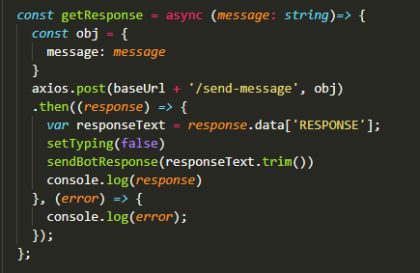
Integration with Backend
Utilized axios library to make requests to Flask server
Utilized promises/callback functions to deal with asynchronous requests
Make sure application doesn’t crash or displays incomplete information
Backend Functionality
Authenticate user on login screen
Register user with info on register screen
Get user data to load data on profile screen
Send message on chat screen

Slide 10
Backend
The backend for the app is a Python Flask APP
It is built using a REST API model, and servers as the layer in between the front end and the model
The backend consists of 4 key endpoints listed below - each endpoint server to implement logic for the frontend
Backend Calls
POST /send-message
GET /authenticate-user/<email>/<password>
POST /register-user
GET /get-user-data

Slide 11
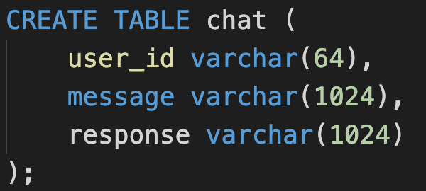
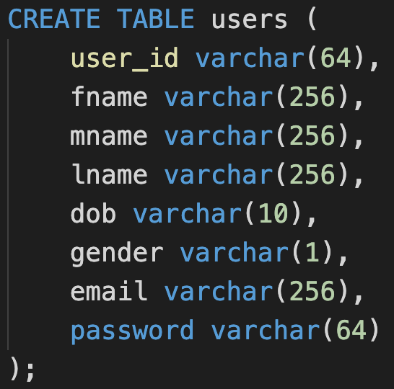
Database
Postgresql database consisting of chat information and user information

Slide 12
Backend Code Walkthrough
Code Walkthrough!

Slide 13
PIP Pipeline
Data processing on Kaggle physical diseases dataset (Patil, 2020)
Determine unique symptoms and assign a numeric label for each unique physical illness
Produces dataset for symptom extraction (enumerates through combinations of 1, 2, 3, and 4 symptoms, subsampling for combinations of size 3 and 4).
Features: messages describing symptoms, built from pre-written message templates.
Data augmentation (done with 40% probability): symptom tokens reversed
Labels: unique symptoms (0 if not present, 1 if present)
Produces dataset for physical illness prediction given symptoms
Features: unique symptoms (0 if not present, 1 if present)
Labels: numeric label for physical illness corresponding to present symptoms

Slide 14
PIP Pipeline
Symptom extraction
TF-IDF vectorization (scikit-learn developers, sklearn.feature_extraction.text.TfidfVectorizer, 2022)
Multi-output classifier (scikit-learn developers, sklearn.multioutput.MultiOutputClassifier, 2022).
Neural networks trained on dataset for symptom extraction (scikit-learn developers, sklearn.neural_network.MLPClassifier, 2022).
Prediction of physical illness given symptom information
Random forest classifier (scikit-learn developers, sklearn.ensemble.RandomForestClassifier, 2022).
Neural network classifier (scikit-learn developers, sklearn.neural_network.MLPClassifier, 2022).
Model evaluation
Model only trained once, validated on several different splits of the data
Accuracy on train/test split
F1 score on train/test split (scikit-learn developers, sklearn.metrics.f1_score, 2022)
K-fold cross validation (scikit-learn developers, sklearn.model_selection.KFold, 2022)
Accuracy and F1 score on each fold

Slide 15
PIP Pipeline
Response building
Top three physical illness predictions and classification probabilities, rounded to one decimal place.
Corresponding precautions from physical diseases dataset, for preventing/mitigating each predicted physical illness (e.g. drink sugary drinks for hypoglycemia) (Patil, 2020).
Assembled into string to show the user, sent to backend, sent to frontend.

Slide 16
MIP Pipeline
Data processing on emotions dataset
Determine most probable mental illness based on distribution of sentiment of series of user messages
Utilizes sklearn logistic regression model to train the classifier (scikit-learn developers, sklearn.linear_model.LogisticRegression, 2022)
Predictions of most likely illness are determined by performing a time series analysis on the messages passed in by the user
Depression: Consistently sad or little joy/happiness
Bipolar Disorder: Wide fluctuations in sentiment between messages
Anxiety: Mix of surprise, fear, and obvious absence of strong sad/joy emotions
Response string is built by providing the user with their most likely illness
Assembled in string to show to the user, then sent to backend, then frontend
Notes:
The first step is data processing on emotions dataset.
The Emotion dataset has features as text samples, and then the labels correspond to actual sentiments (such as fear, joy, anger, surprise) ||||
In terms of data processing, i use pandas to convert the csvs into dataframes that can be fed in to the sklearn classifier. In this case i use the provided logistic regression model, and trained it to an accuracy of about 88%.
Then, the predictions are made by determining the most likely illness via a time series analysis of the messages passed in to the user. For instance, if a user passes in like 5 messages, they are passed into the classifier individually, and then the distribution of sentiment is what causes us to determine the most likely illness, out of Depression (desc), Bipolar Disorder (desc), and Anxiety(desc)
Response string is built by providing the user with their most likely illness, defined by heuristic that we’ll talk about in the next slide

Slide 17
MIP Heuristics
Created heuristics to determine if patients fall into one of 4 categories: depression, anxiety, bipolar, or no mental illnesses
For depression, checked if sentiment of sadness was the most common in a message
For anxiety, checked if sentiment of fear was most common in a message
For bipolar, checked if sentiments often switched from sad/fear to happy throughout a message and if these sentiments were balanced throughout
If the patient fell into none of these categories, he/she was diagnosed with no mental illness

Slide 18
Research
Datasets
Physical diseases dataset: Disease Symptom Prediction (Patil, 2020).
Twitter dataset: Twitter Emotion Analysis (Merin S, 2020).
Emotions dataset: Emotions dataset for NLP (Praveen, 2020).
PIP Pipeline
Symptom extraction
Keyword extraction (RAKE: Rapid Automatic Keyword Extraction) (Saxena, 2020)
Multi-output classifiers (scikit-learn developers, sklearn.multioutput.MultiOutputClassifier, 2022)
MIP Pipeline
Logistic Regression (sklearn developers, sklearn.linear_model.LogisticRegression, 2022)
Notes:
The main research for the mip pipeline was finding a ml classifier that worked the best for our use case.
We use logistic regression for the MIP pipeline, this is because through testing of various models, such as SVMs (Support vector machines) and K nearest neighbors. With those models, the accuracy would cap out at around 80%. Logistic regression seemed to work the best with our emotions dataset, with an accuracy of around 88% after training.

Slide 19
Local Testing
PIP pipeline
Four stages: data processing, fitting symptom extraction model (multi-output classifier of neural networks), fitting each PIP model (random forest, neural network). See command to evaluate already-trained models below.
$ python3 ./models/physical_illness_prediction.py --proc_data 1 --fit_se_nn 1 --fit_pip_rf 1 --fit_pip_nn 1 > ./models/physical_illness_prediction_logs.txt
Response builder (for PIP pipeline)
Tests responses generated by PIP pipeline (14 test cases, 12 / 14 passed). See command to run test cases below.
$ python3 ./test.py > ./response_builder_test_logs.txt
MIP pipeline
Stages: Data processing, Accuracy Training for LR model
$ python3 ./models/mental_illness_prediction.py
See README.md file and corresponding log files for more details.

Slide 20
Solution Demonstration
Demo time!

Slide 21
Future Work
PIP Pipeline
Improve data processing and machine learning techniques (sentence templates, data augmentation, etc.) to improve symptom extraction.
Obtain more data about symptoms corresponding to illnesses, improve performance of PIP models and apply it to more symptoms and illnesses.
MIP Pipeline
Improve heuristic to determine mental illness risks from sentiment analysis information
Support more mental illnesses beyond depression, anxiety, and bipolar disorder.
General
Integration with healthcare organizations to keep providers in the loop with what the patient may be experiencing before any necessary appointments.
Integration with pharmacies to suggest medications that align with the precautions provided to the user by the app.

Slide 22
References
Merin S, S. (2020, April 17). Twitter Emotion Analysis. Kaggle. Retrieved March 6, 2022, from https://www.kaggle.com/shainy/twitter-emotion-analysis/data
Patil, P. (2020, May 24). Disease Symptom Prediction. Kaggle. Retrieved April 27, 2022, from https://www.kaggle.com/itachi9604/disease-symptom-description-dataset
Praveen. (2020, April 16). Emotions dataset for NLP. Kaggle. Retrieved March 6, 2022, from https://www.kaggle.com/praveengovi/emotions-dataset-for-nlp
Saxena, N. (2020, September 6). Extracting Keyphrases from Text: RAKE and Gensim in Python. Extracting Keyphrases from Text: RAKE and Gensim in Python | by Nikita Saxena | Towards Data Science. Retrieved April 27, 2022, from https://towardsdatascience.com/extracting-keyphrases-from-text-rake-and-gensim-in-python-eefd0fad582f
scikit-learn developers. (2022). sklearn.ensemble.RandomForestClassifier. sklearn.ensemble.RandomForestClassifier — scikit-learn 1.0.2 documentation. Retrieved April 27, 2022, from https://scikit-learn.org/stable/modules/generated/sklearn.ensemble.RandomForestClassifier.html
scikit-learn developers. (2022). sklearn.feature_extraction.text.TfidfVectorizer. sklearn.feature_extraction.text.TfidfVectorizer — scikit-learn 1.0.2 documentation. Retrieved April 27, 2022, from https://scikit-learn.org/stable/modules/generated/sklearn.feature_extraction.text.TfidfVectorizer.html

Slide 23
References
scikit-learn developers. (2022). sklearn.linear_model.LogisticRegression — scikit-learn 1.0.2 documentation. Retrieved April 27, 2022, from https://scikit-learn.org/stable/modules/generated/sklearn.linear_model.LogisticRegression.html
scikit-learn developers. (2022). sklearn.metrics.f1_score. sklearn.metrics.f1_score — scikit-learn 1.0.2 documentation. Retrieved April 27, 2022, from https://scikit-learn.org/stable/modules/generated/sklearn.metrics.f1_score.html
scikit-learn developers. (2022). sklearn.model_selection.KFold. sklearn.model_selection.KFold — scikit-learn 1.0.2 documentation. Retrieved April 27, 2022, from https://scikit-learn.org/stable/modules/generated/sklearn.model_selection.KFold.html
scikit-learn developers. (2022). sklearn.multioutput.MultiOutputClassifier. sklearn.multioutput.MultiOutputClassifier — scikit-learn 1.0.2 documentation. Retrieved April 27, 2022, from https://scikit-learn.org/stable/modules/generated/sklearn.multioutput.MultiOutputClassifier.html
scikit-learn developers. (2022). sklearn.neural_network.MLPClassifier. sklearn.neural_network.MLPClassifier — scikit-learn 1.0.2 documentation. Retrieved April 27, 2022, from https://scikit-learn.org/stable/modules/generated/sklearn.neural_network.MLPClassifier.html

Slide 24
Thanks for Listening!

